Slide 1



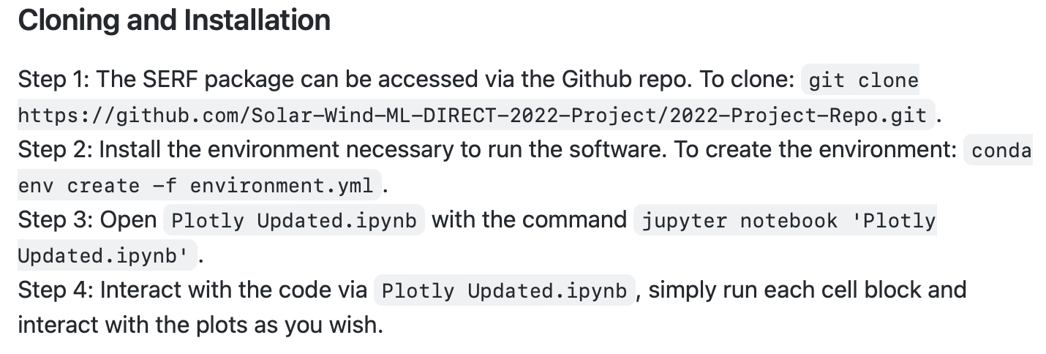
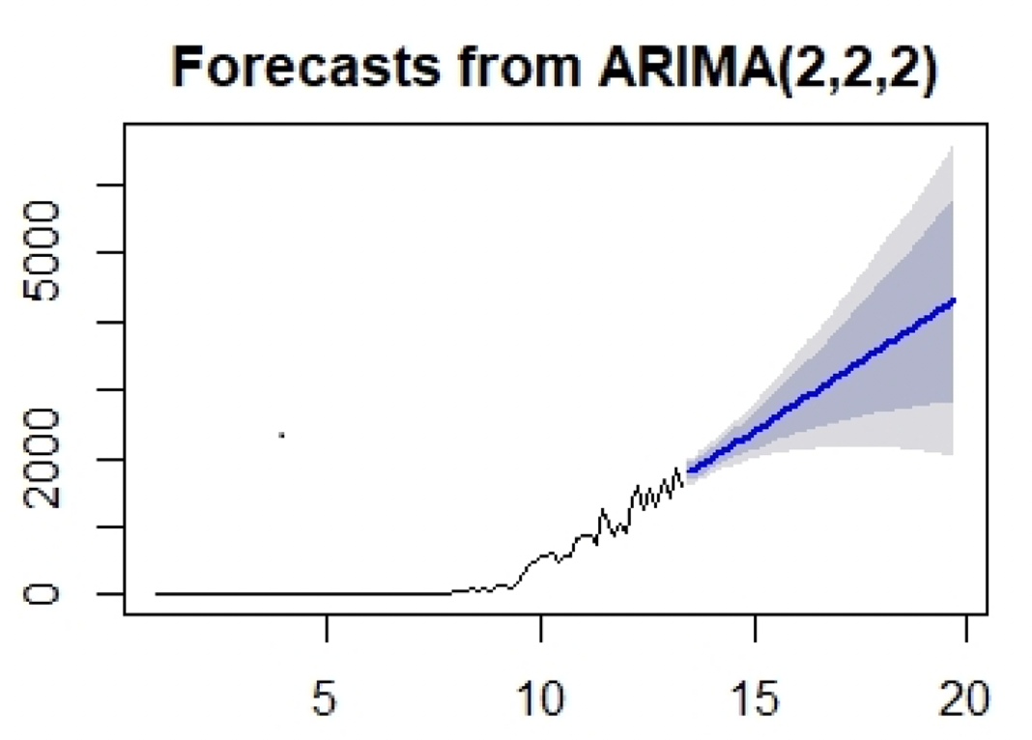
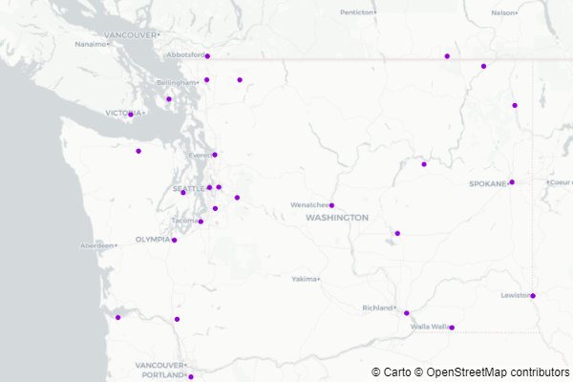
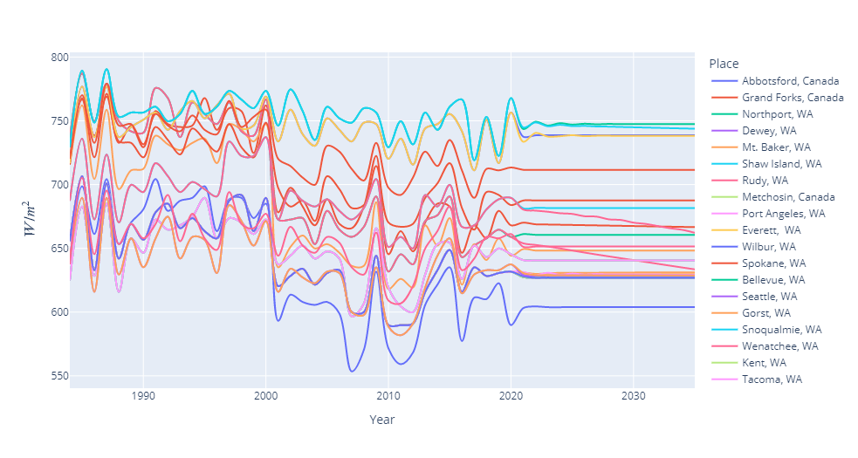
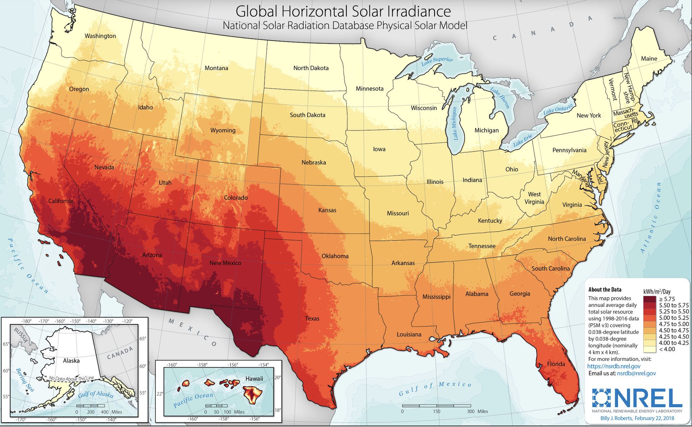
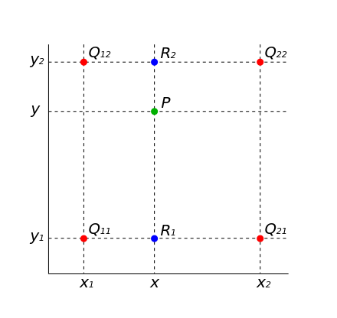
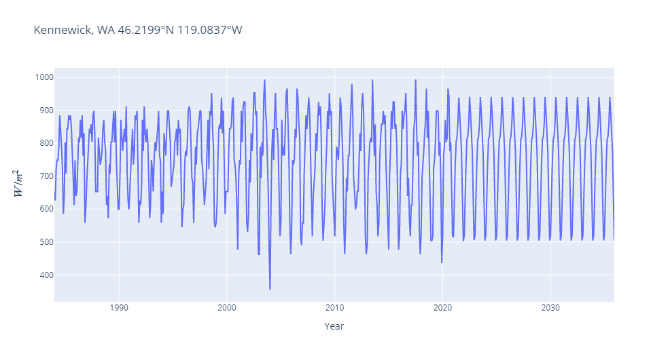

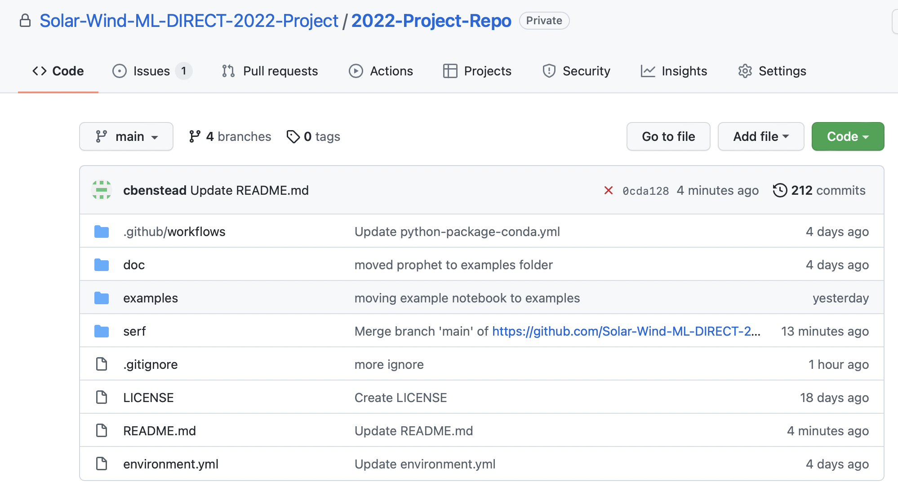
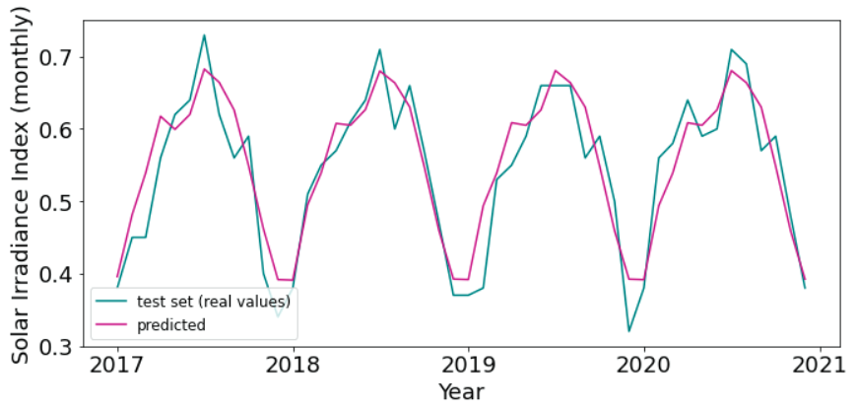

Solar Energy Resource Forecasting
Claire Benstead, Spencer Cira, Isabelle Pacheco, Erick Tieu
Motivation
Use Cases
Using the Interface
Since the beginning of the industrial era, greenhouse gas emissions have grown rapidly as societies have become increasingly energy dependent. Energy infrastructures across the globe have been designed around the consumption of fossil fuels (primarily petroleum-based). As the opacity of Earth’s atmosphere has increased with reference to longwave electromagnetic emission from Earth’s surface, the average temperature of the Earth has gradually increased, a result of growing greenhouse gas concentrations. Most estimates calculate the net energy gain by Earth to be ~1 W/m². Thus, we find ourselves in a position of increasing energy demand with the need to reduce greenhouse gas emissions in order to avoid the damaging effects of climate change. The Earth’s largest energy source, the sun, is also the largest untapped source of energy .
> Utility company seeking to build a grad-scale utility plant. For a company with significant geographical reach, such as a utility company that owns land throughout the Puget Sound region, choosing the right location for a new PV installation is imperative to the economic success of the installation.
> Residential homeowner seeking to install roof PV panels. Although PV technology costs are decreasing, financial cost & benefit analysis is crucial to understanding the ability for an individual homeowner to afford PV.
See README.md file for detailed instructions and usage
Lessons Learned
Using univariate time-series analysis on these datas are quite difficult and results are not necessarily reliable (i.e. confidence intervals grow larger and larger as time goes on).
Forecasts
Plotly visualization tools used within python to produce the following graphics:
ARIMA model for COVID-19 cases in India (Roy S., et. al, Modeling Earth Systems and Environment (2021) 7:1385–1391)
Washington state and its surrounding areas with markers on locations used for the model
Next Steps
SARIMA Introduction
The seasonal autoregressive integrated moving average model is an extension of the autoregressive moving average model (ARIMA) that is fitted to time-series data in order to better understand the data and predict future values in the series. In particular, this type of analysis works well in handling data with non-stationary means but stationary variance. The statsmodels package in python allows for easy access to this method and is the primary method by which the model was utilized in this software.
In order to expand the usefulness of our software, we can (1) add more locations, and (2) add interpolation methods (i.e., bilinear) to get predictions for in-between locations (image from wikipedia)
Solar Irradiance vs. Year, modeled for all the locations analyzed in this software
Global Horizontal Irradiance Map of the U.S (NREL)
Project Goal
Check out our repo!
The goal of this project is to utilize machine learning methods to predict areas in Washington state and its surrounding areas that are more likely to produce high solar irradiances in the future. This piece of software is meant to act as a means for selecting appropriate areas for solar installations, whether residential or grid-scale. We have deployed the SARIMA, seasonal autoregressive integrated moving average, statistical model to produce univariate predictions for solar irradiance.
Solar Irradiance vs. year, modeled for Kennewick, Washington
Solar irradiance vs. year: actual and modeled values in Kennewick, WA
Acknowledgments:
Notes:
✅ An introduction that sets the stage
✅ A brief overview of the motivating use case(s) [note, this is not all, just the most important]
Loading….. A description of the software design to meet the use case(s)
✅ A description of the data science methods you used
Any conclusions you have come to about the performance of your methods
✅ (let’s talk about this during the presentation) Describe your team dynamics, who did what, how did you communicate and plan
Loading……Next steps and lessons learned

Slide 2
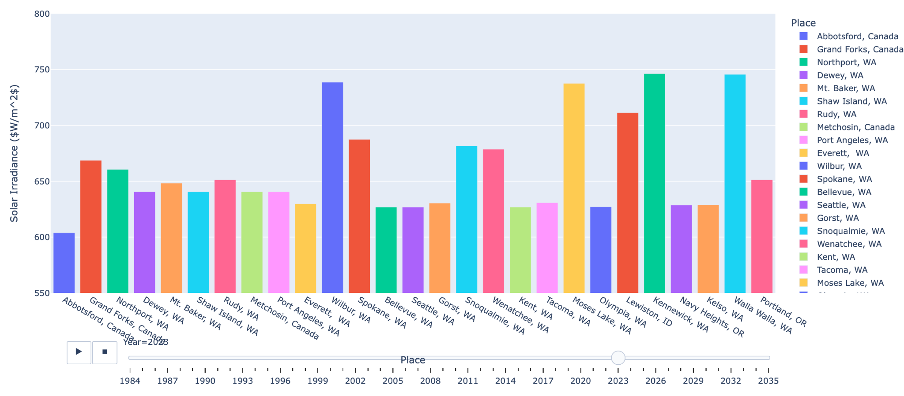
Predictions bar graph with time file:///Users/spencercira/Downloads/Yearly%20Averages%20bar%20graph.html

Slide 3
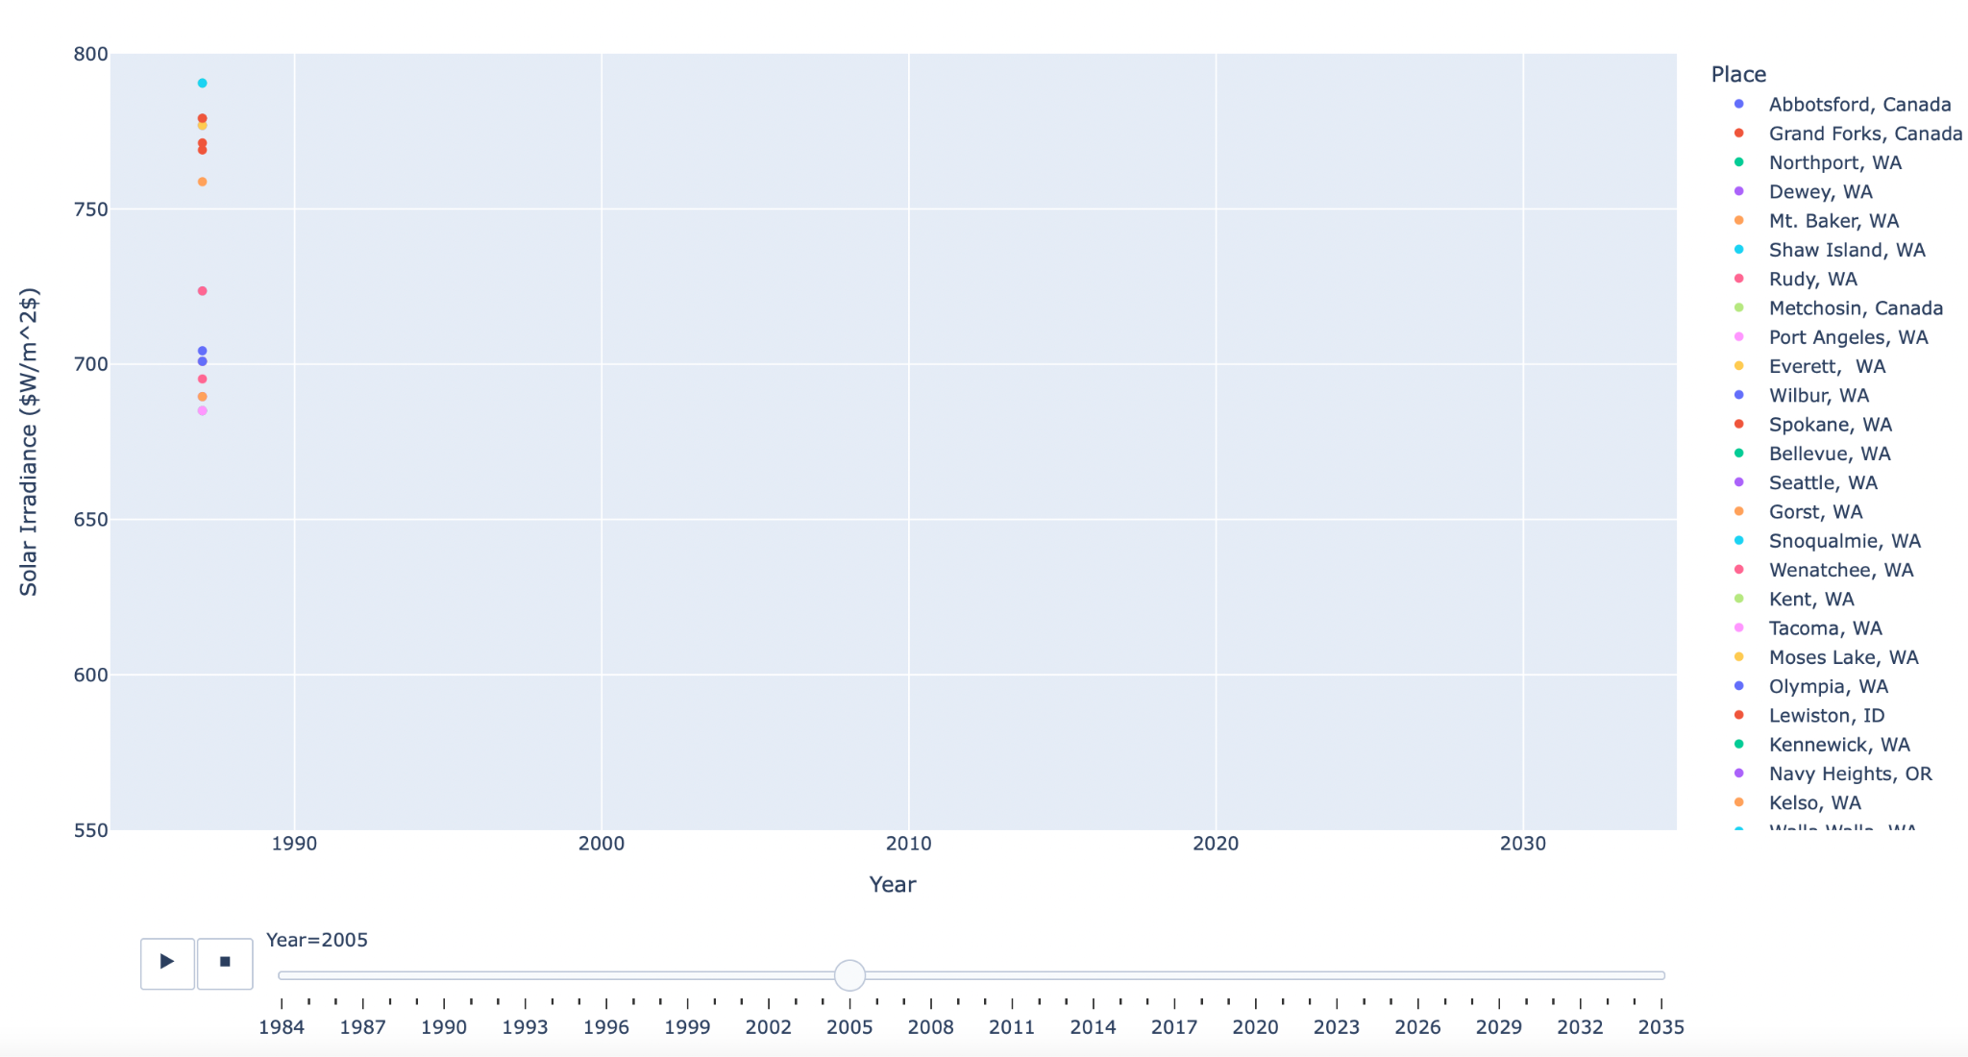
Predictions scatter plot with time file:///Users/spencercira/Downloads/Yearly%20Averages.html
Fitting
Forecasting

